Slide 1
DevOps Pipeline Implementation to Enhance Infotainment Software Delivery In Modern Vehicles.
A Comprehensive Overview of Technologies and Use Case
Presented By : Ashish Rahane
In Guidance of : Shripad Sathe Sir, Nikhil Muley.

Slide 2
Index
Goal
Introduction to DevOps
Objectives
Use case of the Project
Current Development Process
Benefits Of CI/CD over Current Process
Graphical Representation of CICD Pipeline
Overview Of CICD Pipeline
Tools Used in Pipeline
Challenges and Solutions
Conclusion
Future Consideration
Thank You.

Slide 3
Goal: Develop and implement a CI/CD pipeline to automate the build, test, and deployment processes for the car’s infotainment application, accelerating the SDLC and improving efficiency for developers.

Slide 4
Introduction to DevOps
DevOps combines development (Dev) and operations (Ops) to increase the efficiency, speed, and security of software development and delivery compared to traditional processes. A more nimble software development lifecycle results in a competitive advantage for businesses and their customers.
CI/CD plays a crucial role in enabling faster release cycles. By automating the integration and deployment processes, teams can push out updates more regularly, often multiple times a day. This not only allows businesses to adapt to changes swiftly but also gives them a competitive edge.

Slide 5
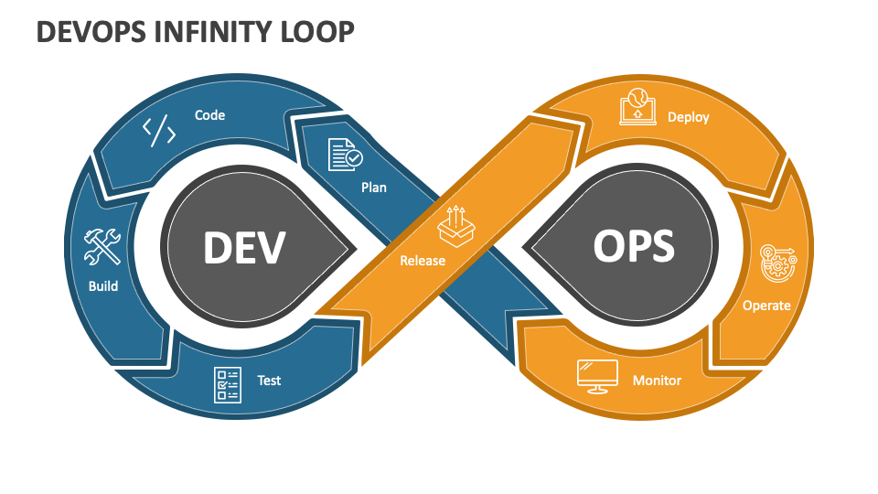

Slide 6
Objectives:
1. Automate Build Process:
Set up a continuous integration (CI) system to automatically build the infotainment application whenever code changes are committed to the repository.
Ensure the build process includes compiling code, resolving dependencies, and packaging the application.
2. Automate Testing:
Integrate automated testing into the CI pipeline to run unit tests, integration tests, and end-to-end tests.
Ensure that any code changes pass all tests before being merged into the main branch.

Slide 7
3. Code Quality Check:
Implement tools to perform static code analysis and code quality checks as part of the CI pipeline.
Ensure that the code adheres to coding standards and best practices before proceeding to the next stages.
4. Artifact Registry:
Set up an artifact registry to store built artifacts, such as compiled binaries or Docker images.
Ensure that the pipeline pushes the built artifacts to the registry after successful builds and tests.

Slide 8
5. Continuous Delivery (CD):
Configure the pipeline to automatically deploy the application to a staging environment for further testing and validation.
Implement automated deployment to the production environment upon successful testing in staging, with manual approval if necessary.
6. Monitoring and Feedback:
Set up monitoring tools to track the performance and health of the deployed application.
Implement feedback loops to provide developers with real-time insights into build and deployment statuses, as well as any issues that arise.

Slide 9
6. Documentation:
Document the CI/CD pipeline setup and usage instructions for the development team.
Also, Documentation helps others in the DevOps team to debug the any issue happening in the CICD pipeline.

Slide 10
Use Case:
Scenario: The current manual deployment process for the car’s infotainment application is slow and error-prone.
Solution: Implementing a CI/CD pipeline automates these processes, significantly reducing deployment times and errors, and improving efficiency for developers.

Slide 11
Current Development Process:
Manual Builds: Developers manually compile the code, which is time-consuming and prone to errors.
Manual Testing: Testing is done manually, leading to inconsistent results and longer feedback loops.
Manual Deployments: Deployment to production is done manually, increasing the risk of errors and downtime.
Siloed Teams: Development and operations teams work in isolation, causing delays and miscommunication.
Limited Visibility: Tracking changes and their impacts is difficult, leading to potential issues going unnoticed.

Slide 12
Benefits and Use Case of CI/CD Pipeline
Automation: Streamlines the build, test, and deployment processes, reducing manual tasks and errors.
Continuous Integration/Continuous Deployment (CI/CD): Accelerates deployment cycles, allowing for faster delivery of updates and features.
Improved Collaboration: Enhances teamwork and communication between development and operations teams.
Scalability: Adapts to the growing complexity and size of the infotainment application.
Monitoring and Logging: Provides better insights and faster issue resolution, improving overall system reliability.

Slide 13
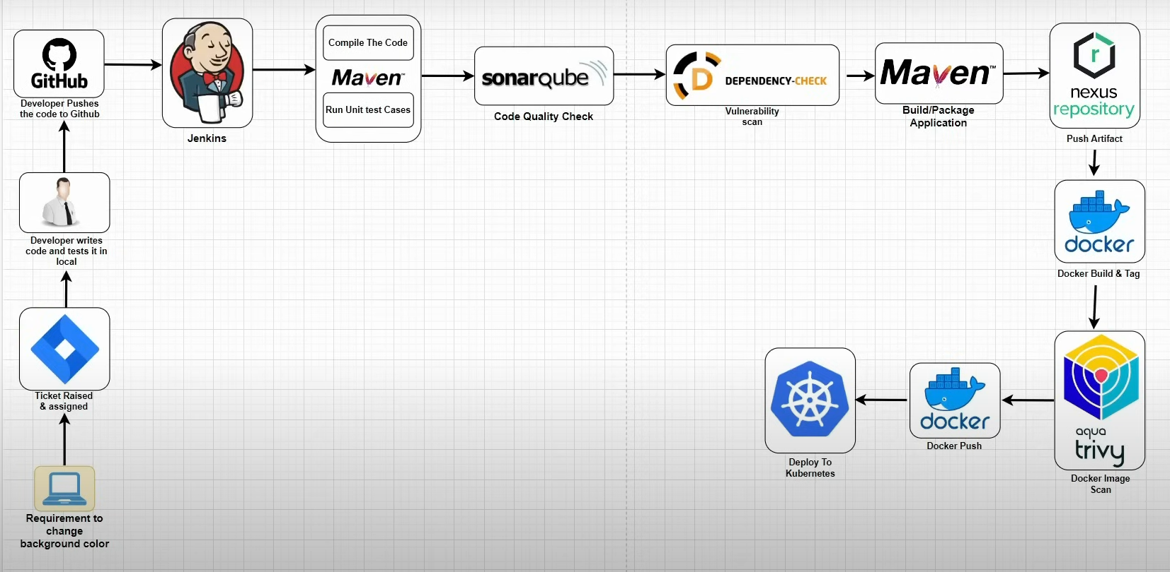
Graphical Overview of CI/CD Pipeline

Slide 14
3. DevOps CI/CD Pipeline Overview to Deploy Web App:
Version Control: Developers use Git to manage the web app's code and create branches for specific infotainment adaptations like UI changes or integration with vehicle systems.
1
Containerization: The web app is containerized using Docker or a similar tool to ensure it works seamlessly across various car models with different infotainment hardware.
2
CI/CD Pipeline: Jenkins/GitLab CI pipelines automatically build, test, and prepare the app for deployment after each commit. The pipeline deploys the web app to an internal testing environment where it is validated on actual car infotainment systems.
4
Manual Deployment to Cars: Once validated, the app is manually deployed to production, installed directly into the car’s infotainment system for internal use, allowing users to start shopping for car parts and accessories.
Automated Testing: Every code change triggers automated tests (UI compatibility, performance, and security) to ensure smooth operation on infotainment systems.
3

Slide 15
Tools Used in the CI/CD Pipeline
SonarQube:
Purpose: Analyses code quality and security.
Key Features: Static code analysis, bug detection, and code quality metrics.
Usage: Configured to run after each build to provide feedback on code quality and potential vulnerabilities.
Nexus:
Purpose: Manages artifacts and dependencies.
Key Features: Repository management, artifact storage, and version control.
Usage:. Stores build artifacts and dependencies, ensuring consistent and reliable access for builds and deployments

Slide 16
Tools Used in the CI/CD Pipeline
Git:
Purpose: Version control system for tracking changes in source code.
Key Features: Distributed version control, branching and merging, and collaboration support.
Usage: Used to manage source code, track changes, and facilitate collaboration among developers.
Jenkins:
Purpose: Automates the build and deployment process.
Key Features: Continuous integration, extensive plugin ecosystem, and easy configuration.
Usage: Configured to trigger builds automatically on code commits, run tests, and deploy artifacts.

Slide 17
Tools Used in the CI/CD Pipeline
Docker:
Purpose: Containerizes applications for consistent deployment.
Key Features: Containerization, isolation, and scalability.
Usage: Used to create container images of the application, ensuring consistency across different environments.
Trivy:
Purpose: Scans containers for vulnerabilities.
Key Features: Vulnerability scanning, compliance checks, and integration with CI/CD pipelines.
Usage: Integrated into the pipeline to scan Docker images for vulnerabilities before deployment.

Slide 18
Tools Used in the CI/CD Pipeline
Kubernetes:
Purpose: Orchestrates containerized applications.
Key Features: Container orchestration, scaling, and automated deployment.
Usage: Manages the deployment, scaling, and operation of containerized applications, ensuring high availability and reliability.

Slide 19
Branching Strategies
Git Flow: A robust branching model that uses feature branches and multiple primary branches (main and develop).
Feature Branches: Used for developing new features. Each feature is developed in its own branch, which is eventually merged back into the develop branch.
Develop Branch: Integrates features for the next release. It is the main branch for ongoing development.
Main Branch: Contains production-ready code. Only stable releases are merged into this branch.

Slide 20
Importance of Managing Feature Development in the Automotive Domain:
Safety and Reliability: Ensures that new features are thoroughly tested and do not introduce bugs or vulnerabilities.
Parallel Development: Allows multiple features to be developed simultaneously without interfering with each other.
Traceability: Provides a clear history of changes, making it easier to track and manage the development process.
Collaboration: Facilitates better collaboration among team members by isolating feature development.

Slide 21
Challenges and Solutions
Key Challenges Faced During Implementation | Solutions and Lessons Learned:
Integration Complexities | Conducted thorough research and planning, used plugins and APIs for compatibility.
Tool Selection | Evaluated multiple tools and conducted pilot tests to choose the best fit.
Team Adaptation | Provided comprehensive detailed documentation.
Initial Setup Time | Allocated dedicated resources and time for setup.
Security Concerns | Implemented security best practices and regular vulnerability scans.

Slide 22
Conclusion
The implementation of a CI/CD pipeline for the car’s infotainment application will brought significant improvements to our development process. By automating the build, test, and deployment stages, we will achieved:
Increased Efficiency: Automation has reduced manual errors and speed up the development cycle, allowing us to deliver updates and new features more quickly.
Enhanced Collaboration: The pipeline has fostered better communication and collaboration between development and operations teams, breaking down silos and improving overall workflow.
Faster Deployment: Continuous integration and continuous deployment (CI/CD) practices have enabled us to deploy changes more frequently and reliably, ensuring that our application remains up-to-date and responsive to user needs.
Improved Security and Quality: Regular security scans and code quality checks have ensured that our application is robust and secure, minimizing vulnerabilities and maintaining high standards of code quality.
Scalability: The pipeline is designed to scale with the growing complexity and size of the infotainment application, ensuring that it can handle increased demand and new features seamlessly.

Slide 23
Future Consideration
Looking ahead, there are several areas where we can continue to improve and optimize our CI/CD pipeline:
Continuous Improvement: Regularly updating and optimizing the pipeline to incorporate new technologies and best practices will help us stay ahead of the curve.
Advanced Monitoring: Implementing more sophisticated monitoring tools will provide deeper insights into the pipeline’s performance and help us identify and resolve issues more quickly.
Enhanced Security Measures: Continuously enhancing our security practices will protect against emerging threats and ensure the integrity of our application.
Feedback Loops: Establishing stronger feedback loops with developers and operations teams will provide valuable insights for ongoing improvements and ensure that the pipeline meets the evolving needs of our project.

Slide 24
In conclusion, the CI/CD pipeline has been a transformative addition to our development process, driving efficiency, collaboration, and quality. By continuing to refine and enhance the pipeline, we can ensure that our car’s infotainment application remains at the forefront of innovation and user satisfaction.

Slide 25
Thank You
Thank you for giving me the opportunity to present my project on developing and implementing a CI/CD pipeline for the car’s infotainment application. I appreciate the time and effort you have invested in reviewing my work.
This project has been a significant learning experience for me.
Your feedback and guidance have been invaluable, and I look forward to your insights on how we can further enhance our CI/CD practices.
Thank you once again for your support and consideration.
Best regards, Ashish Rahane

